Slide 1

AI Agents for Everyday Health: Transforming Wellness with Personalized AI Assistants
July 24th, 2024
Ted Fitch
UMGC, MS in Data Analytics (candidate)
Insight Student Summit

Slide 2
What if….
…you had your own doctor or counselor on call 24/7?
…you had a simple way to reduce your stress, remember to take your vitamins, and increase longevity?
…you had a caring health advocate that could come with you to each appointment?
…you could get the healthcare you need in your own native language?
| AI Agents for Everyday Health | 07/24/24

Slide 3


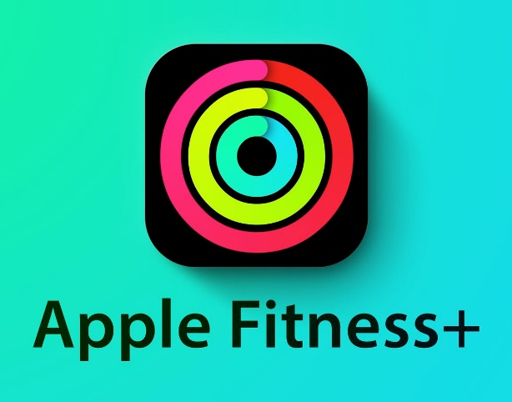
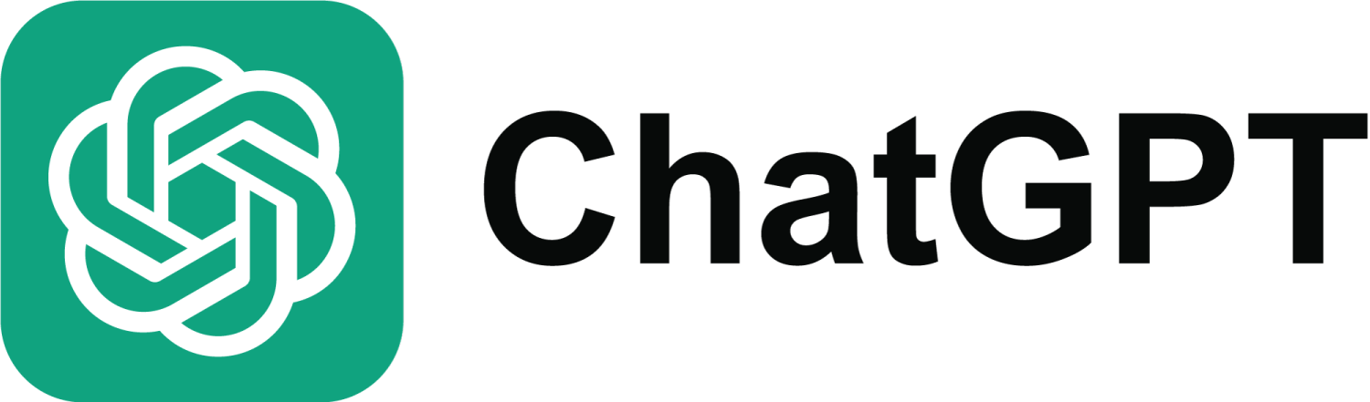
1. Introduction
AI Agents: AI-powered digital assistants with tunable personalities designed to support mental, physical, and emotional well-being in their assigned human’s daily life.
Table of Contents
Introduction
AI Agents Will be Personalized Healthcare
Capabilities of AI Agents
Opportunities for AI in Healthcare
AI Overwhelmingly Helps in Healthcare Settings
Challenges and Considerations
Self Advocacy and Self Agent(cy)
Future Implications
| AI Agents for Everyday Health | 07/24/24

Slide 4
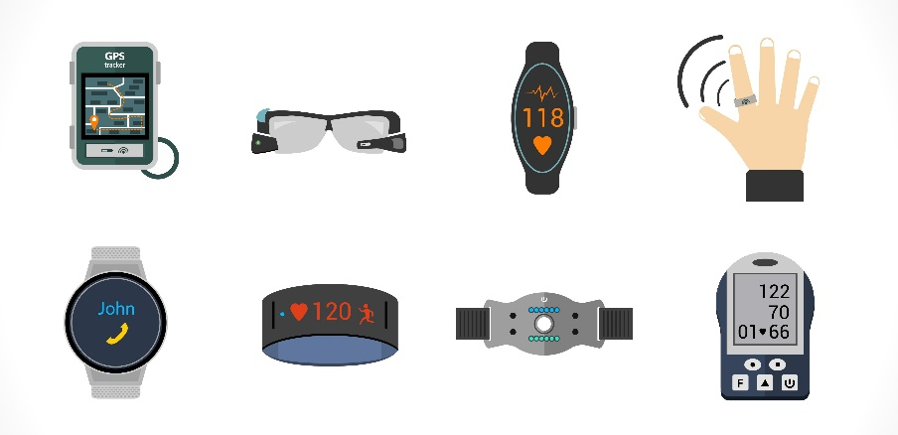
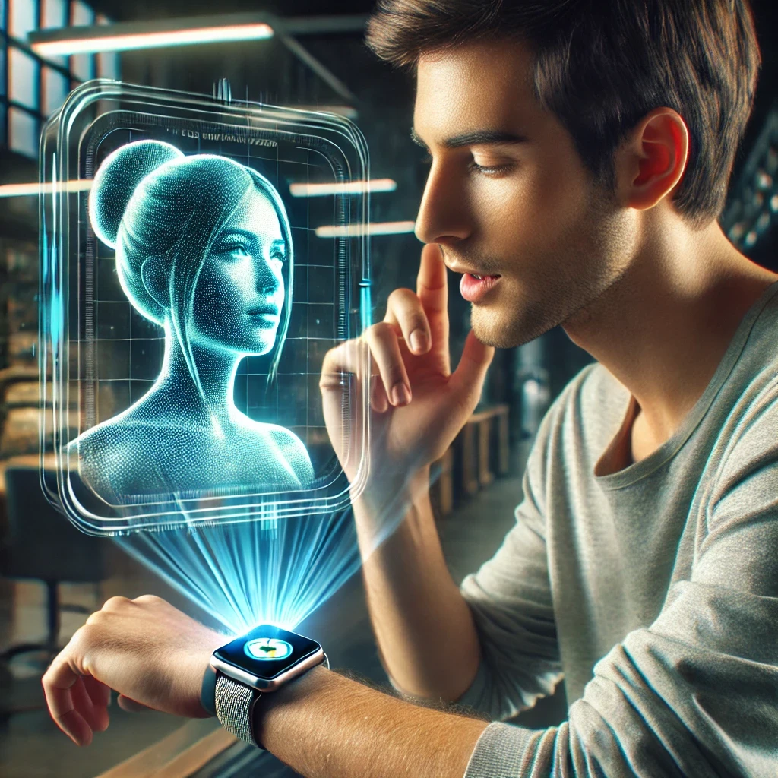
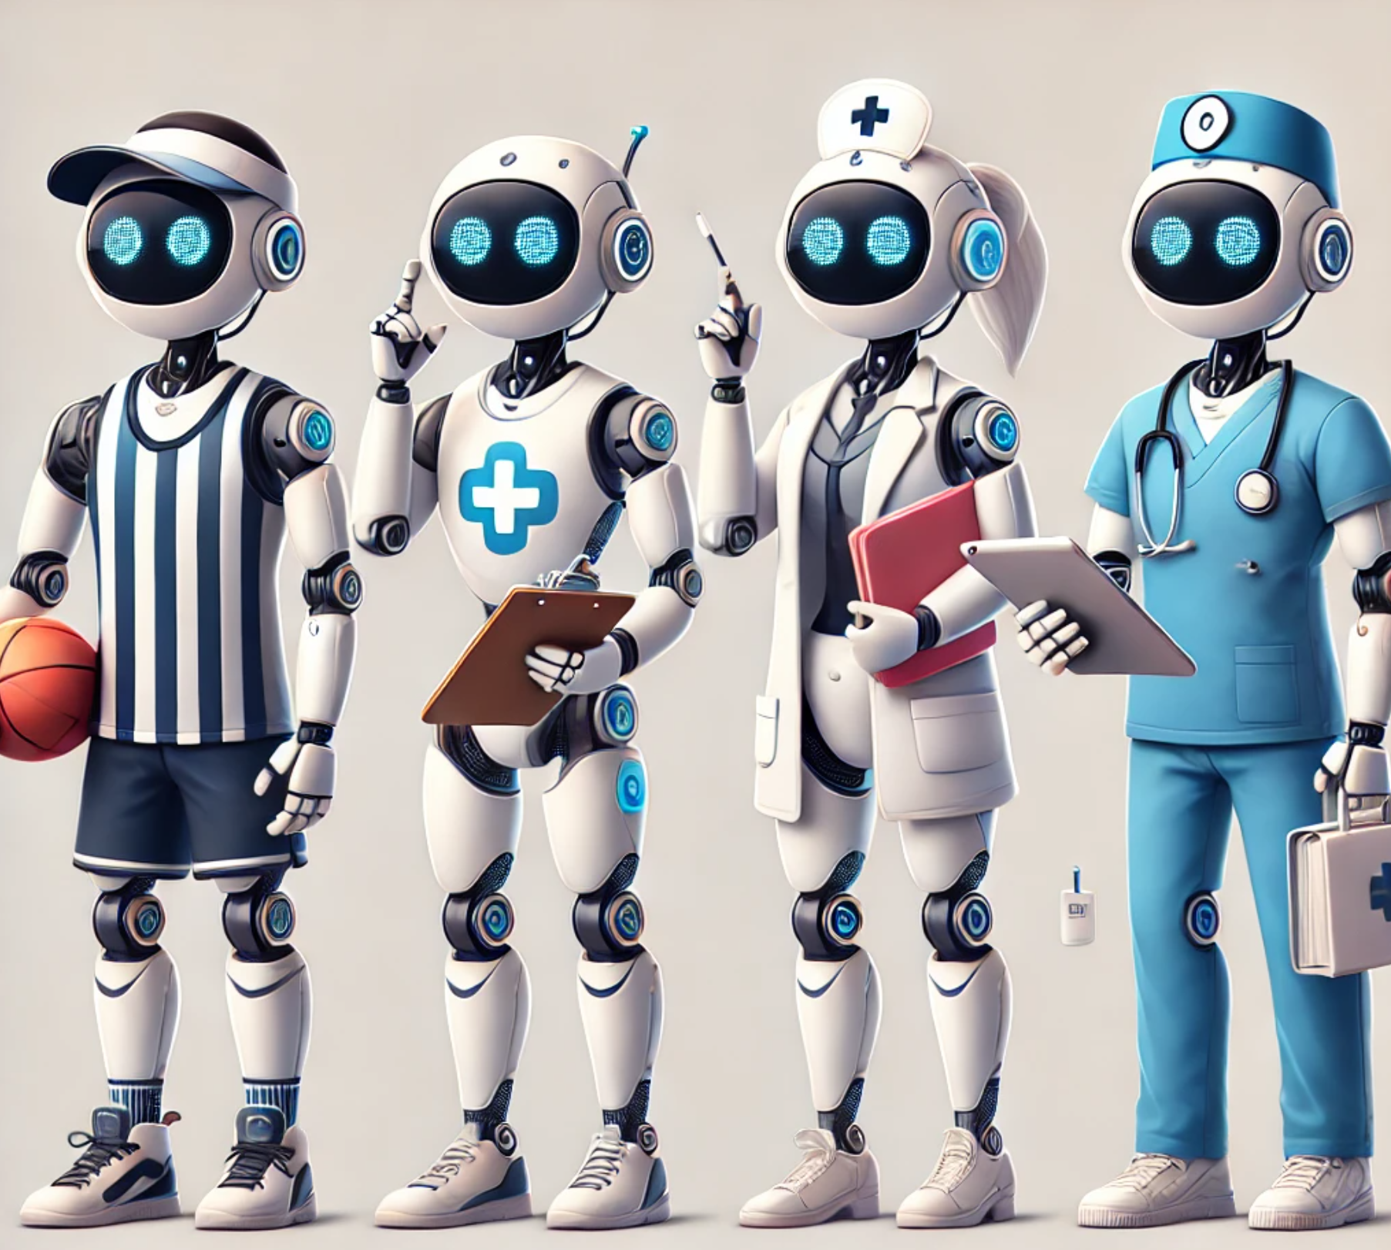
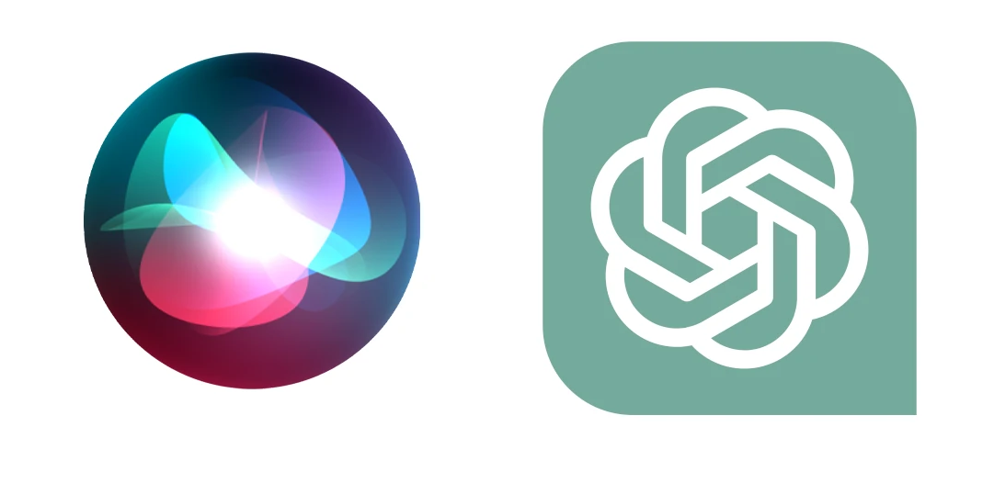
2. AI Agents Will be Personalized Healthcare
Wearables are widely accepted and enjoyed for their ease of use and status symbols (Oura, Whoop)
AI Agents could take on the role most needed by the patient: whether a coach, counselor, assistant or doctor. Agents could be sold as a product to act as a personal health advocate for an individual.
AI Agents could be interacted with via wearable devices, and personalized (voice, avatar appearance, personality traits, etc.)
Chatbots and virtual assistants are widely used for their ease of use, utility, and efficiency
| AI Agents for Everyday Health | 07/24/24

Slide 5
3. Capabilities of AI Agents
- Vital Sign Tracking: AI agents can integrate with wearable devices to monitor heart rate, weight, blood pressure, and other vital signs, providing real-time feedback on health metrics
- Medication Management: AI agents can remind users to take medications on time, track adherence, and provide educational information about prescribed drugs and potential side effects
- Mood Monitoring: AI agents can analyze speech patterns, facial expressions, and text messages to assess mood and offer coping strategies
- Habit Tracking: AI agents can track daily habits such as exercise routines, sleep patterns, and dietary choices, offering personalized recommendations for healthier behaviors
- Stress Management: AI agents can guide users through relaxation techniques such as deep breathing exercises, mindfulness meditation, and progressive muscle relaxation
- Personalized Healthcare: AI agents can deliver suggestions, encouragement, and interactions based on each patient’s unique personality
- Healthcare Training: AI agents can offer a way for patients to gain general healthcare knowledge with a very low barrier to entry
- Language Barrier Elimination: AI agents could instantly switch languages supporting ESL patients and to practice English while confirming words in their primary language
Physical
Mental/ Emotional
Equality
| AI Agents for Everyday Health | 07/24/24

Slide 6
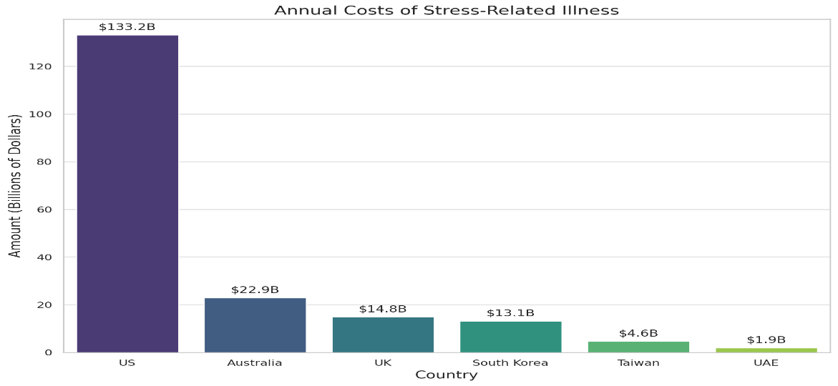
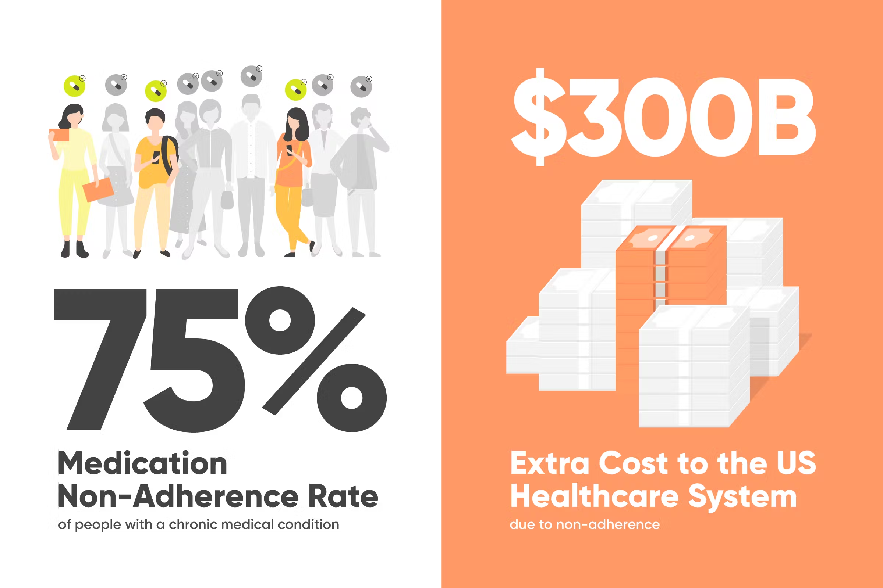
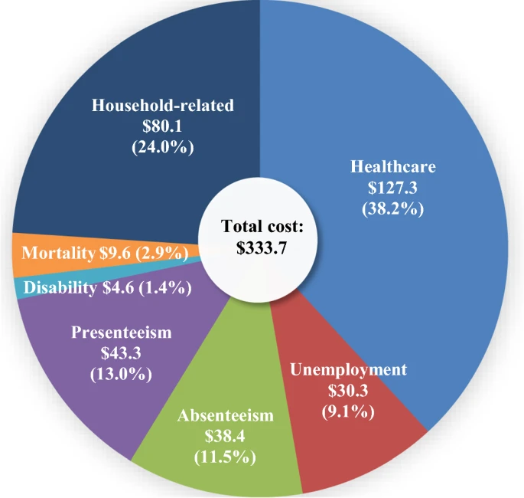
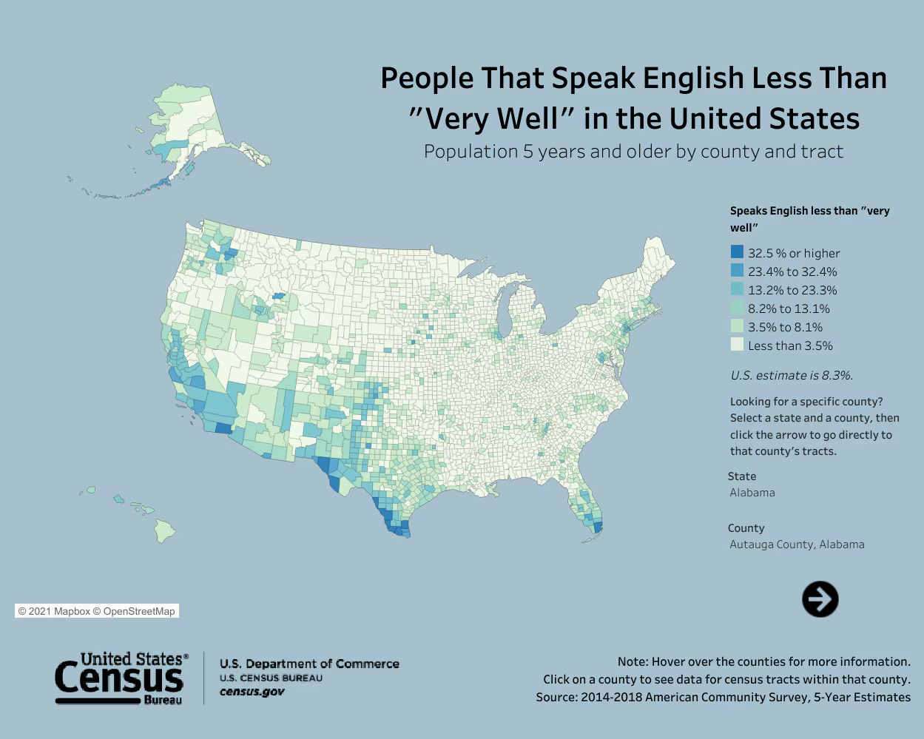
4. Opportunities for AI in Healthcare
Stress reduction: (Cigna, 2019) | Protocol Adherence: (Herohealth, n.d.)
Depression Management: $333.7 billion in annual USA cost (Greenberg et al., 2023) | Language Barrier: 8.3% of USA - 27.7M people (United States Census Bureau, n.d.)
| AI Agents for Everyday Health | 07/24/24

Slide 7



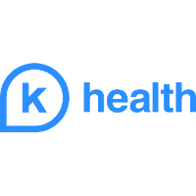

5. AI Overwhelmingly Helps in Healthcare Settings
Chatbot providing medical eligibility, verification, and referral information for insurance customers prior to appointments. Processes >7,000 calls per day (IBM, 2023)
Chatbot implemented in Hong Kong to answer customer questions in both English and Cantonese with a 91% question resolution rate and 3x faster response time (Meta, n.d.)
Zydus Hospitals used chatbots speaking English, Hindi, and Gujarati to give customers personal attention in appointments, ask about their symptoms, and direct them to make an appoint with the correct specialist. In 2 years, they had 20,000 appointments booked (6x baseline), 640,000 chats with customers, and generated $1M in revenue (Sadana, n.d.)
K Health chatbot has treated 3 million patients with 84.2% accuracy in diagnosis (Jennings, 2023)
Northeastern chatbot made to help with preventative care treated patients and saw increased metrics in diet and exercise. A similar chatbot treated palliative patients and saw decreases in anxiety about their illness and eventual death, and also helped them formed plans for their passing with their families (Bickmore et al., 2013)(Utami et al., 2017)
| AI Agents for Everyday Health | 07/24/24

Slide 8
6. Challenges and Considerations
Privacy Protection
Ethical Use of AI
User Empowerment
Regulatory Compliance
Accessibility and Inclusivity
| AI Agents for Everyday Health | 07/24/24

Slide 9
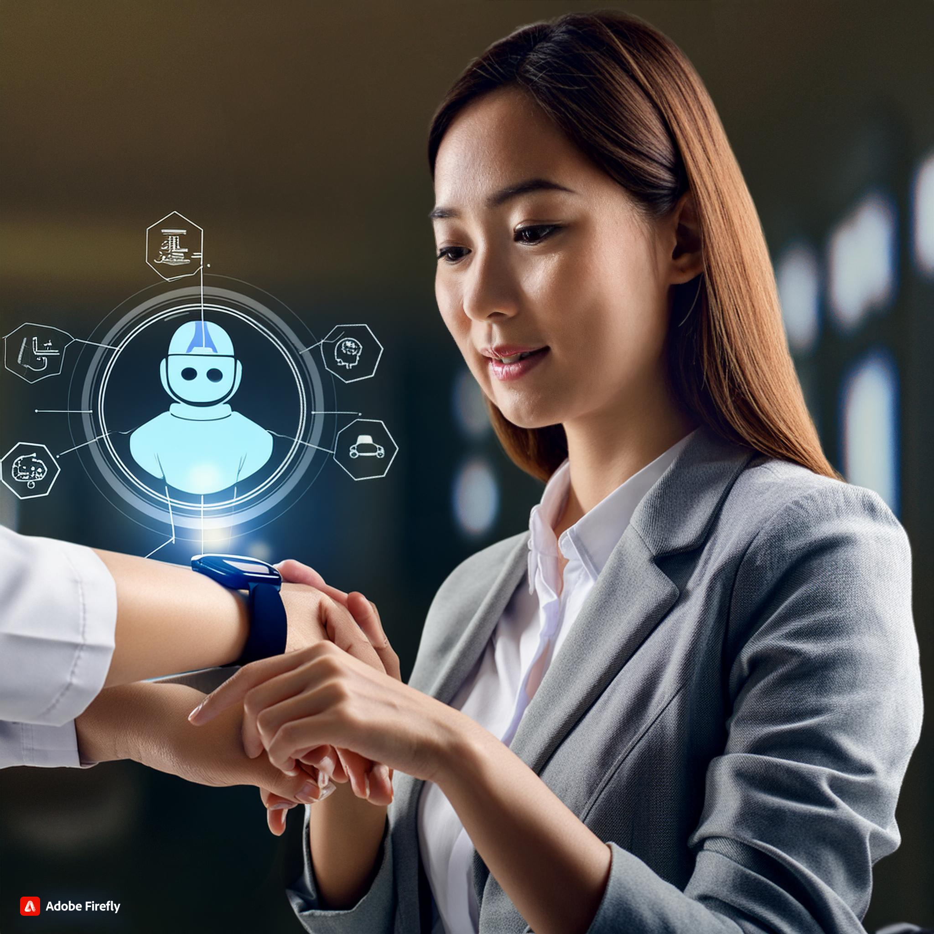
7. Self Advocacy and Self Agent(cy)
AI Agents empower patients to take control of their health
They empower patients to confidently discuss treatment options with doctors and insurance companies alike
They give patients access to healthcare on demand
AI Agents Self Advocacy Wins:
Decrease appointment wait times
Act during traumatic, life-threatening events
Increase well-being by managing chronic disease
Detect sudden changes in mood, vitals, habits, etc.
Offer alternative pharmaceutical/holistic treatments
Increase self-directed preventative care
Decrease medical malpractice
Records challenging symptoms when patient is distressed
Integrates with other technology, stores medical records
Special care for elderly, mentally handicapped, vulnerable populations
Spread awareness during public health crises (like COVID-19)
Centralizes care between multiple providers into the patient’s hands
| AI Agents for Everyday Health | 07/24/24

Slide 10
8. Future Implications
Personalized Healthcare Ecosystem | AI agents become integrated into a comprehensive healthcare ecosystem, collaborating with wearable devices, mobile apps, electronic health records, telemedicine platforms, and virtual reality simulations to deliver seamless, personalized, and continuous care across the lifespan.
Precision Health Predictions | AI agents leverage advanced analytics, predictive modeling, and machine learning algorithms to forecast individual health trajectories, identify early warning signs of disease onset or exacerbation, and recommend targeted interventions for risk mitigation and disease prevention, enabling proactive, personalized, and preemptive healthcare strategies.
Collaborative Care Coordination | AI agents facilitate interdisciplinary collaboration and care coordination among healthcare providers, patients, caregivers, and community resources, streamlining communication, decision-making, and resource allocation to optimize patient outcomes, enhance patient experience, and reduce healthcare costs.
Global Health Equity | AI agents contribute to reducing health disparities and promoting health equity by addressing social determinants of health, improving access to healthcare services, empowering marginalized populations, and advocating for policy changes that prioritize health equity and social justice on a local, national, and global scale.
Ethical AI Governance | AI agents adhere to ethical AI principles, guidelines, and frameworks, ensuring transparency, accountability, fairness, and responsibility in their design, development, deployment, and evaluation, fostering trust, acceptance, and adoption among users, stakeholders, and society at large.
| AI Agents for Everyday Health | 07/24/24

Slide 11
References:
Dalle3 and Firefly
Images throughout
Bickmore, T. W., Schulman, D., & Sidner, C. (2013). Automated interventions for multiple health behaviors using conversational agents. Patient education and counseling, 92(2), 142-148.
Cigna. (2019). Impact of Stress on Healthcare Systems. Cigna Healthcare. https://www.cignaglobal.com/blog/thought-leadership/impact-of-stress-on-healthcare-systems
Greenberg, P., Chitnis, A., Louie, D., Suthoff, E., Chen, S. Y., Maitland, J., Gagnon-Sanschagrin, P., Fournier, A. A., & Kessler, R. C. (2023). The Economic Burden of Adults with Major Depressive Disorder in the United States (2019). Advances in therapy, 40(10), 4460–4479. https://doi.org/10.1007/s12325-023-02622-x
Herohealth. (n.d.). It’s time to talk about taking your medicine. Herohealth. https://herohealth.com/blog/medication-adherence/time-to-talk-about-taking-your-medicine/
IBM. (2023). Expertise on call. IBM. https://www.ibm.com/case-studies/humana
Jennings, K. (2023). This AI Chatbot Has Helped Doctors Treat 3 Million People–And May Be Coming To A Hospital Near You. Forbes. https://www.forbes.com/sites/katiejennings/2023/07/17/this-ai-chatbot-has-helped-doctors-treat-3-million-people/
Meta. (n.d.). Cigna Hong Kong. Meta. https://www.facebook.com/business/success/cigna-hong-kong
Sadana, K. (n.d.). Zydus Hospitals. Wotnot. https://wotnot.io/customers/zydus-hospitals
United States Census Bureau. (n.d.). Languages Spoken at Home. United States Census Bureau. https://www.census.gov/acs/www/about/why-we-ask-each-question/language/
Utami, D., Bickmore, T., Nikolopoulou, A., & Paasche-Orlow, M. (2017). Talk about death: End of life planning with a virtual agent. In Intelligent Virtual Agents: 17th International Conference, IVA 2017, Stockholm, Sweden, August 27-30, 2017, Proceedings 17 (pp. 441-450). Springer International Publishing.
| AI Agents for Everyday Health | 07/24/24

Slide 12
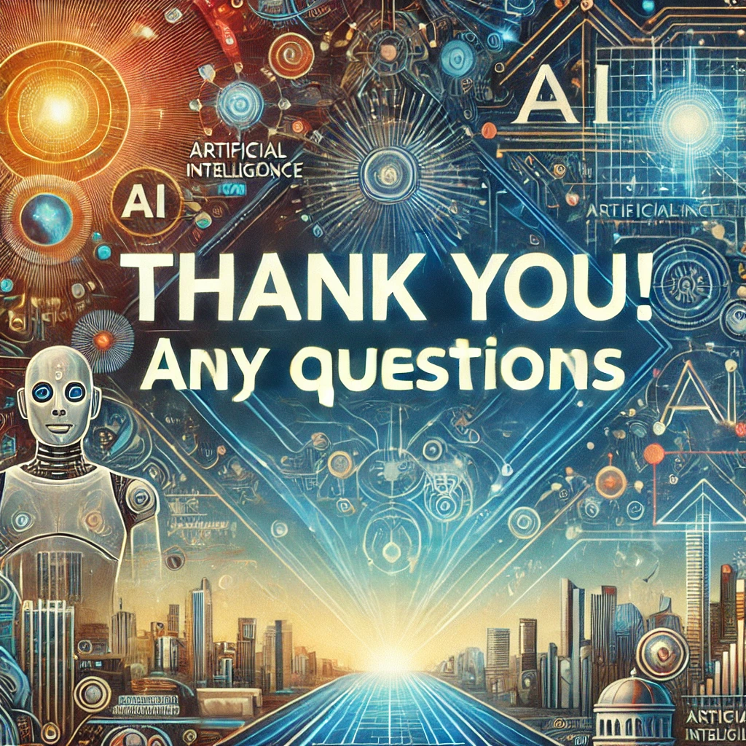
| AI Agents for Everyday Health |
Tedfitch4@gmail.com
https://www.linkedin.com/in/ted-fitch-172062109/
“My interest is in the future because I am going to spend the rest of my life there.”
– Charles Kettering

